Slide 1
InClass 09
Carlos Rosario

Slide 2
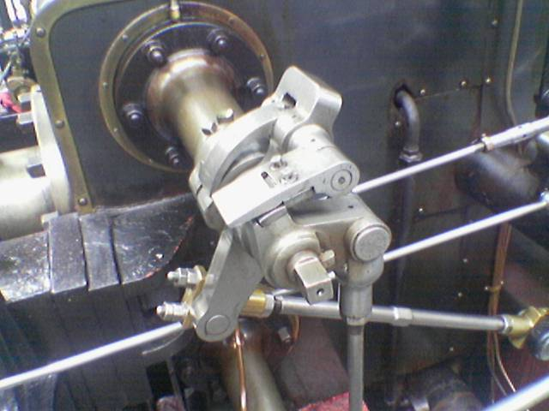
Input Image

Slide 3
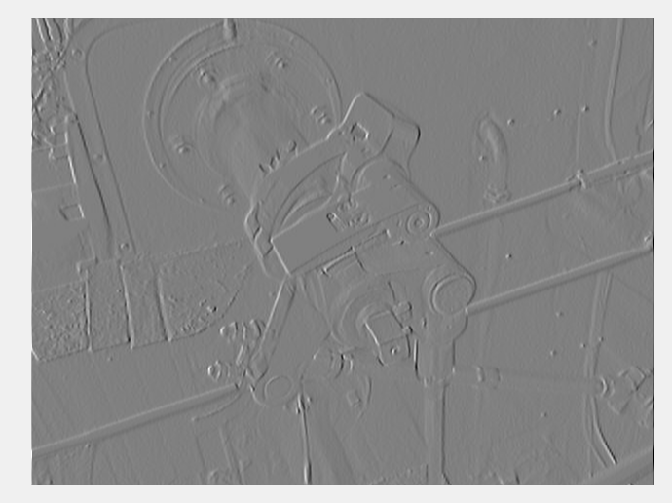
Visualization of Gradient X-direction

Slide 4
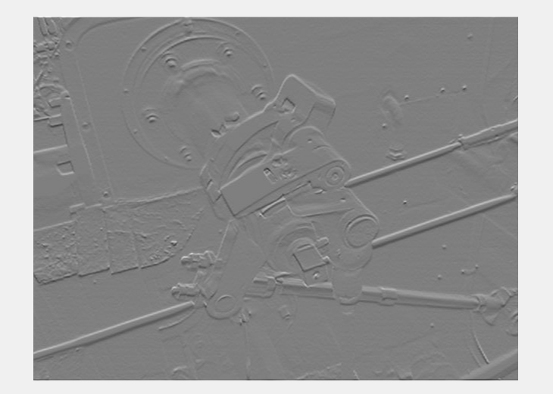
Visualization of Gradient Y-direction

Slide 5
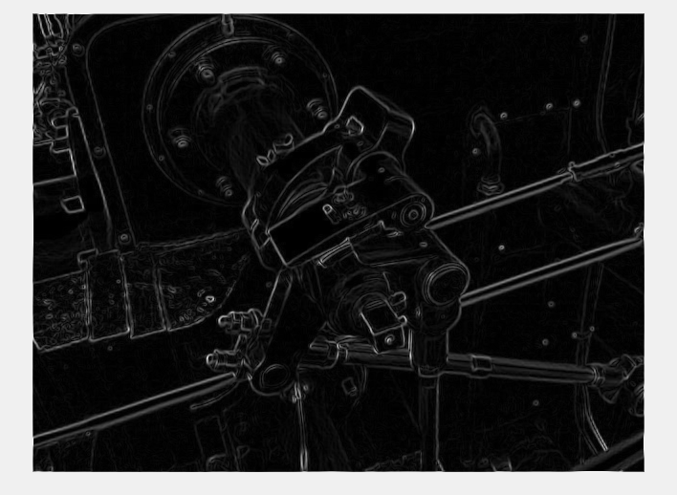
Visualization of gradient magnitude

Slide 6
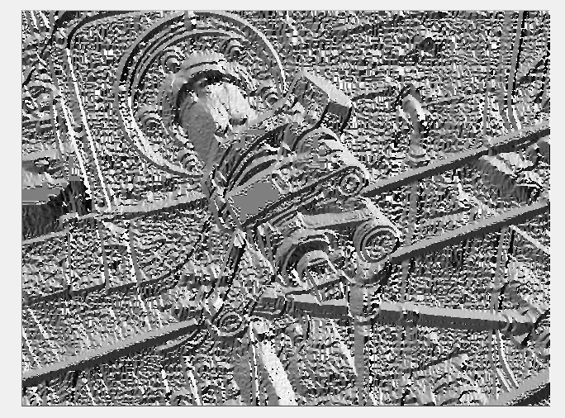
Visualization of gradient direction

Slide 7
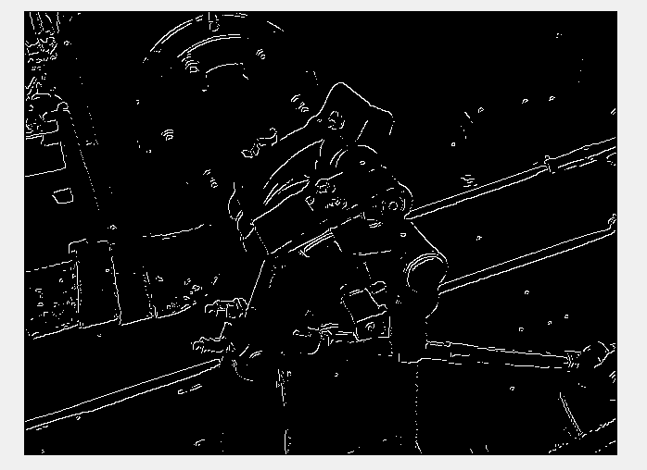
Strong edge map alpha = .09, T = 22

Slide 8
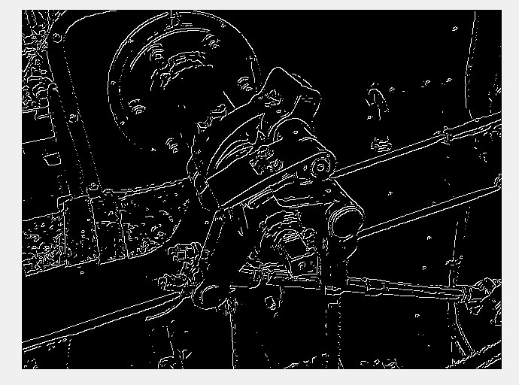
Weak edge map alpha = 0.9, beta =, Thigh = 22, Tmin = 11

Slide 9
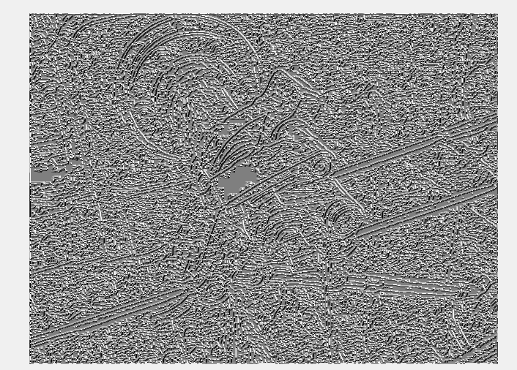
Gradient magnitude with and without non-max supression
without
with

Slide 10
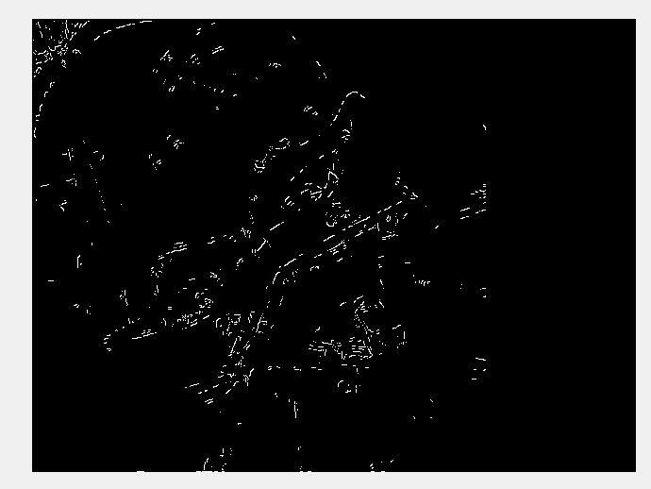
Strong edge, and edges detected during hysteresis
Strong edges
Edges detected during hysteresis

Slide 11
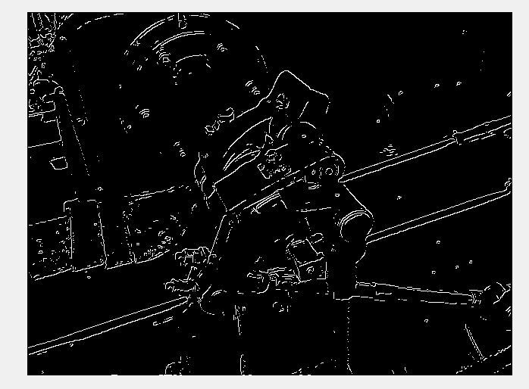
Final Binary Image

